Slide 1
Osher Lifelong Learning Institute, Fall 2023
Contemporary Economic Policy
West Virginia University
Fall, 2023
National Economic Education Delegation

Slide 2
Course Outline
Contemporary Economic Policy
  Week 1 (10/6): Economic Update (Geoffrey Woglom, Amherst College)
  Week 2 (10/13): Trade and Globalization (Avik Chakrabarti, U of Wisconsin Milwaukee)
  Week 3 (10/27): Economics of Immigration (Robert Gitter, Ohio Wesleyan)
  Week 4 (11/3): Monetary Policy (Geoffrey Woglom ,Amherst College)
  Week 5 (11/10): Federal Debt (Joseph Carolan, Oakland University)
  Week 6 (11/17): International Institutions (Alan Deardorff University of Michigan)

Slide 3
Submitting Questions
Please submit questions in the chat.
  I will try to handle them as they come up but may take them in a bunch as time permits (or if the answer is coming later in the presentation)
We will do a verbal Q&A once the material has been presented.
  And address questions in chat that have not been addressed.

Slide 4


The US Federal Debt
West Virginia University
November 10, 2023
Joseph Carolan, Ph.D.
Oakland University

Slide 5
Debt: Feelings….
Feelings about debt – often personal
How you feel….depends on
  Experiences
  Risk profile
  Many other things..
Let’s start with some definitions & concepts that help

Slide 6
Federal Debt: definition
‘Deficit’ vs ‘Debt’
  Fiscal year Deficit = Total Outlays Less Revenues
  Accumulated value of past borrowing is total government debt.
NOTE: Debt = negative savings

Slide 7
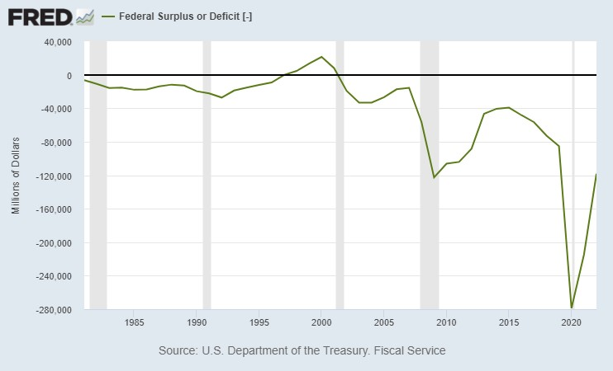
A History of Persistent Deficits
Notes:
Debt2deficit.png

Slide 8
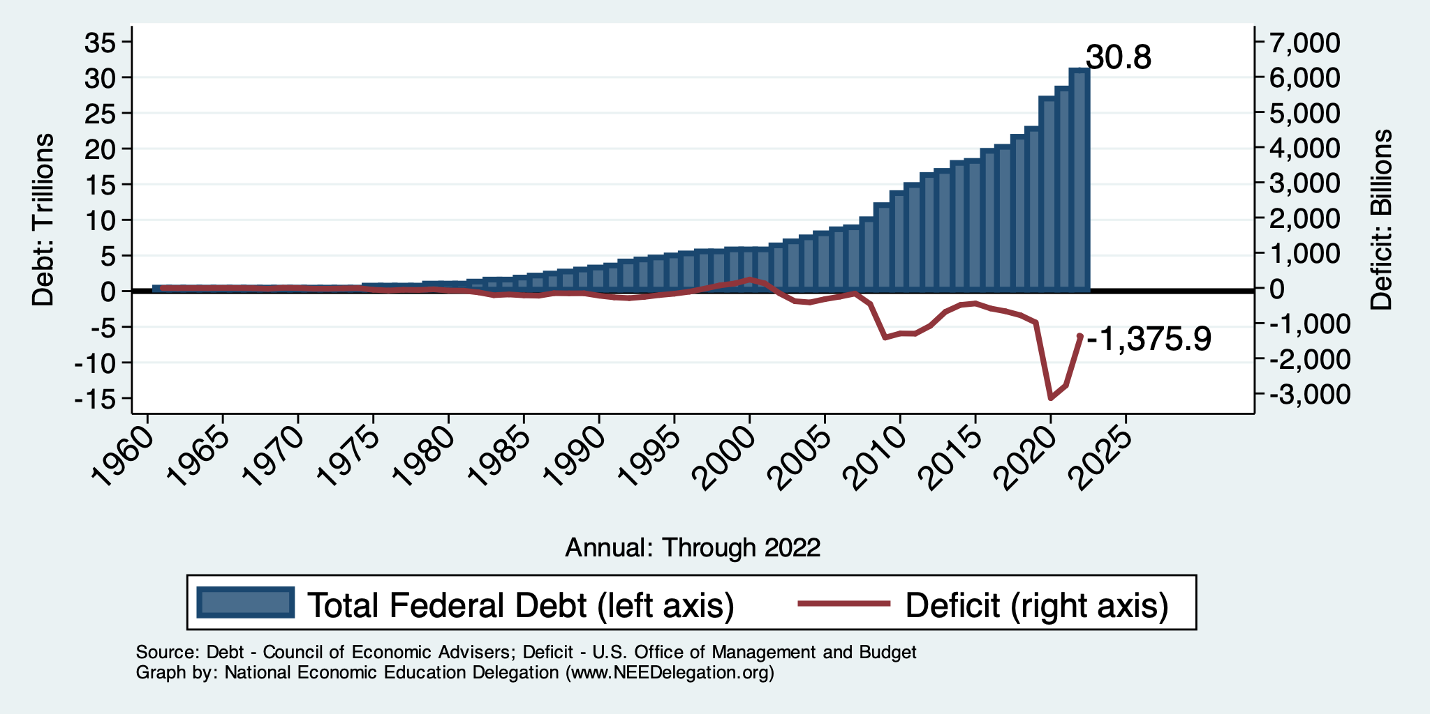
Debt vs. Deficit
Debt = The Sum of All Past Deficits Less Surpluses
Notes:
Debt2deficit.png

Slide 9
Federal Debt: measures of debt
Total Debt vs. Publicly-held Debt
‘Relative’ debt (AKA – “debt to GDP ratio”)

Slide 10
A Breakdown of the Total Federal Debt
Sources: US Treasury, Federal Reserve Board

Slide 11
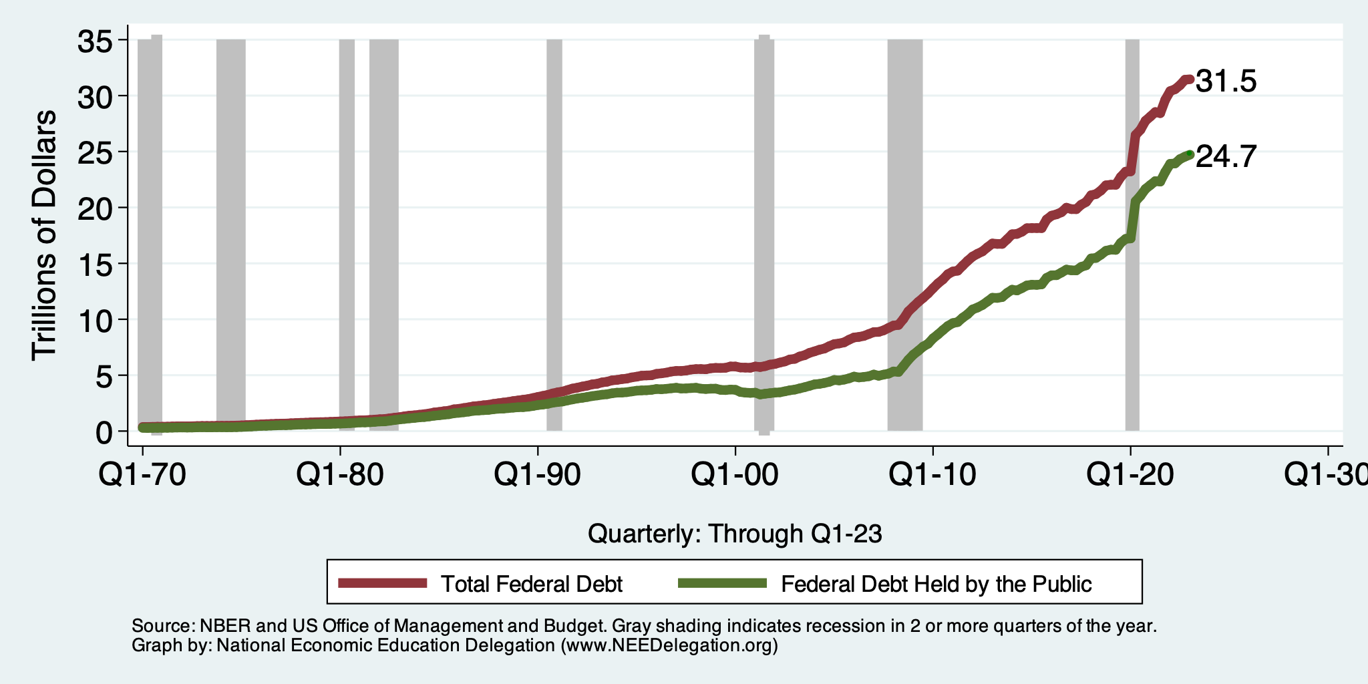
Two Measures of the Debt

Slide 12
Key Idea: Public Debt
Why just public debt? Has to be “repaid” & is subject to interest rate fluctuation
  Process of repayment: “rolling over” (in a bit)
  Interest rate fluctuations: will explore a bit later
For now, consider internal debt just bookkeeping, public debt needs to be “repaid” so we

Slide 13
Key Idea: Relative Debt
Most analyses focus on public debt relative to size of the economy (i.e. GDP)
Relative debt is a fraction: Debt/GDP
Can decrease if:
  The numerator falls (means: have budget surplus)
  The denominator rises (i.e. GDP grows)
  OR, the denominator (GDP) grows faster than the numerator (debt)

Slide 14
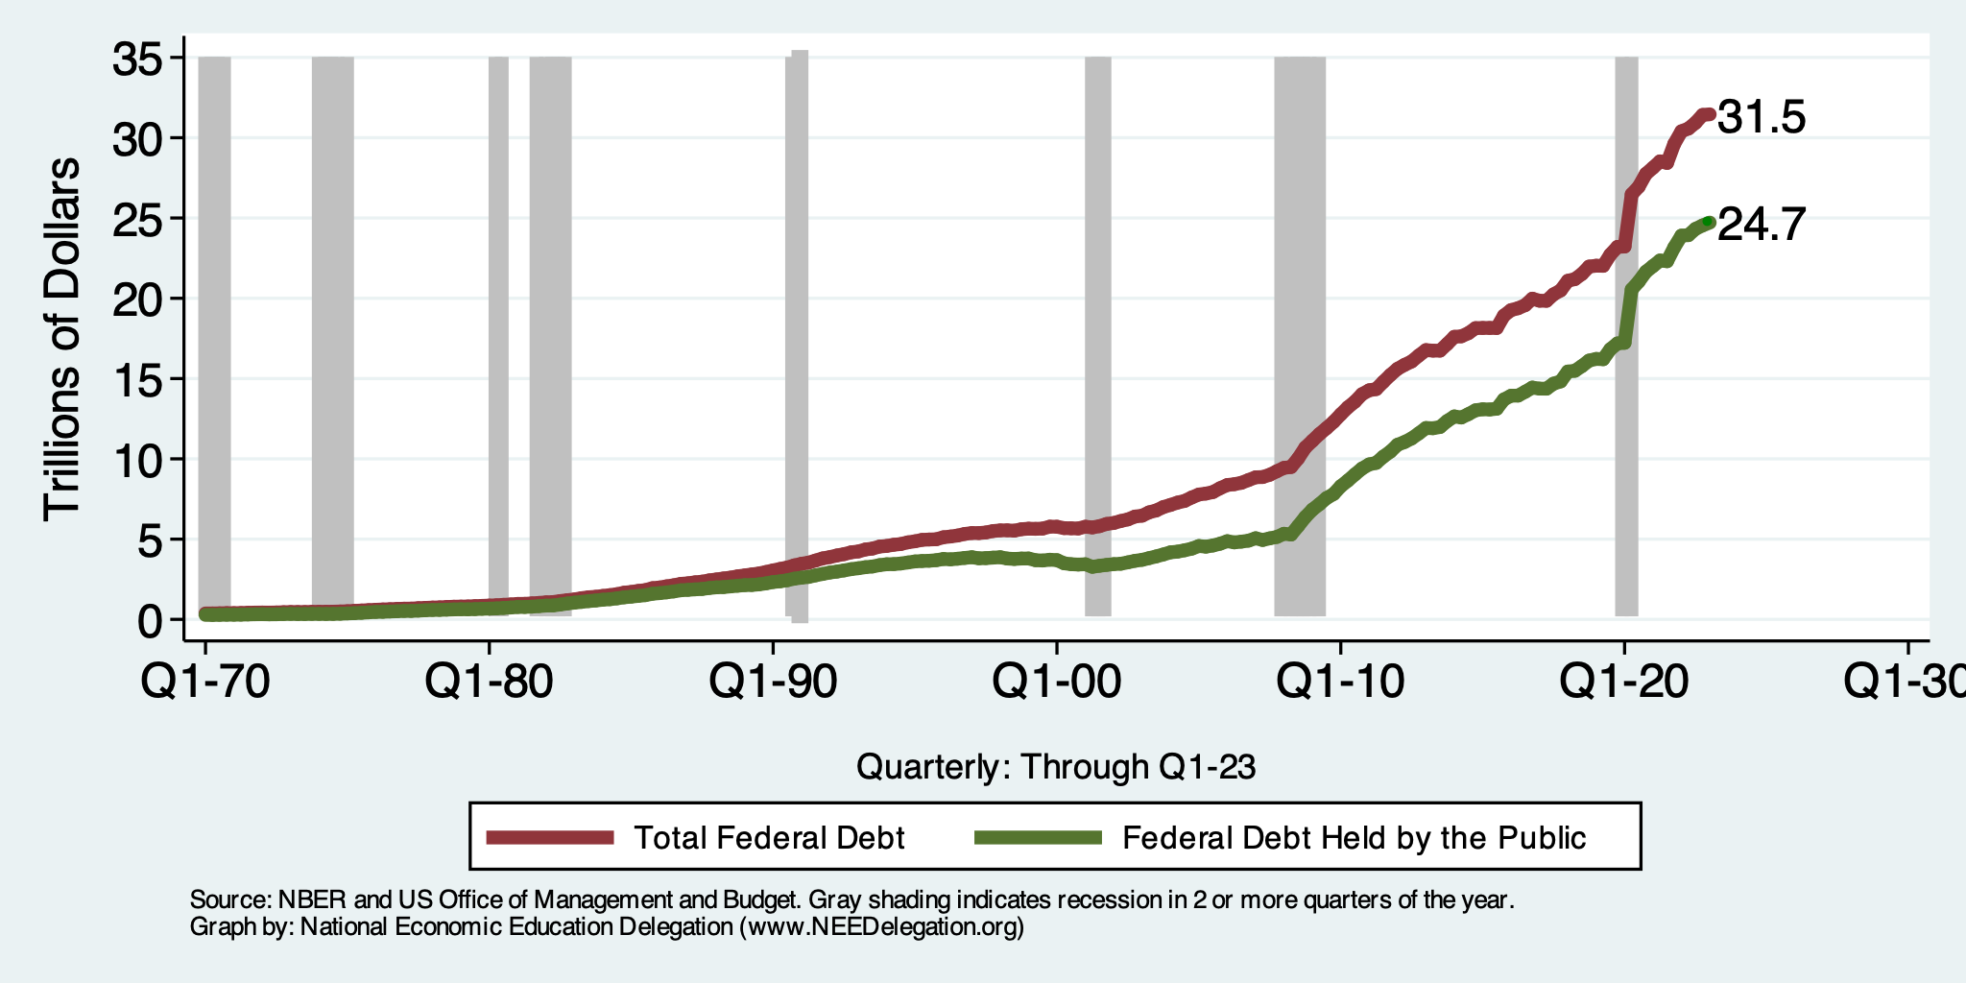
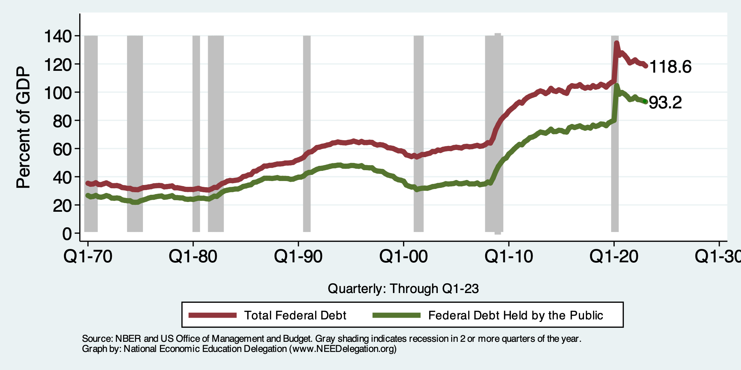
Two Measures of RELATIVE Debt

Slide 15
Debt: Personal & Federal
What do we use it for / why need it?
From whom / how do we get it? Does is matter from whom?
When does it become problem?

Slide 16
Debt: What do we use it for ? (1)
Unexpected emergencies – we need $ now!
Economic investment (not speculating, economic investment which creates long term value greater than the cost of capital, i.e. ROI>WACC)
  Education
  Think: businesses – using it to grow!

Slide 17
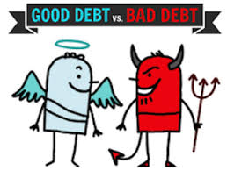
Common belief: Not All Govt Borrowing Is Bad!
Two good reasons to borrow:
  During a temporary crisis
    Recession
    War
    Pandemic
  Productive public investment
    Infrastructure
    Education
These deficits do not permanently increase relative debt.
  Great Depression, WWII → Great Recession? COVID?
  Public investment expands GDP and tax revenue → ROI > WACC

Slide 18
What the US Govt. Budget Looked Like 2019
2019 Budget Summary (in billions)
NOTE: Programmatic Outlays = ‘Mandatory’ + ‘Discretionary’
More to come in moments
Revenue |  |  | Outlays
Income Taxes | $1,718 |  | Mandatory | $2,735
Payroll Taxes | $1,243 |  | Discretionary | $1,336
Corporate Taxes | $230 |  | Interest | $376
Other | $271
Total | $3,462 |  | Total | $4,447
Budget Deficit: $984 Billion
Source: Congressional Budget Office, The Budget and Economic Outlook: 2020 to 2030
Notes:
https://www.cbo.gov/publication/53627
https://www.cbo.gov/publication/53624

Slide 19
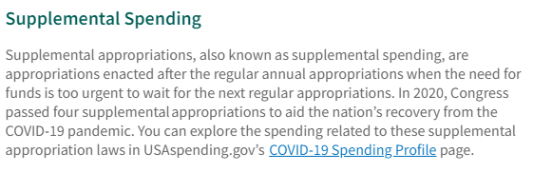
What the U.S. Gov’t Budget Looked Like 2020
Fiscal 2020 Budget Summary
Revenue | Billions |  | Outlays | Billions
Income Taxes | $1,609 |  | Mandatory | $2,315
Payroll Taxes | $1,310 |  | Discretionary | $3,850
Corporate Taxes | $212 |  | Interest | $387
Other | $289
Total | $3,420 |  | Total | $6,552
Budget Deficit: $3,132
Source: Congressional Budget Office, Monthly Budget Review, Nov 2020
Notes:
https://www.cbo.gov/publication/53627
https://www.cbo.gov/publication/53624

Slide 20
Debt: What do we use it for ? (2)
Unexpected emergencies – we need $ now!
Use it for investment (not speculating, economic investment which creates value greater than the cost of capital – ROI>WACC)
  Education
  Think: businesses – using it to grow!
Don’t make enough to cover expenses
Buy things you want now, don’t have the money → implies you will have it later

Slide 21
Why Has the Federal Debt Risen So Much?

Slide 22
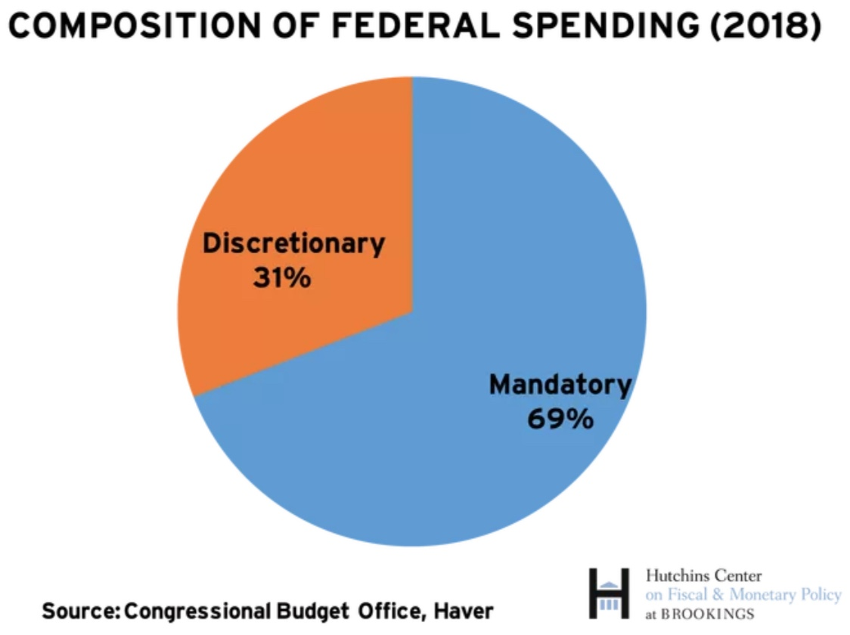
On What is the Money Spent? Complicated

Slide 23
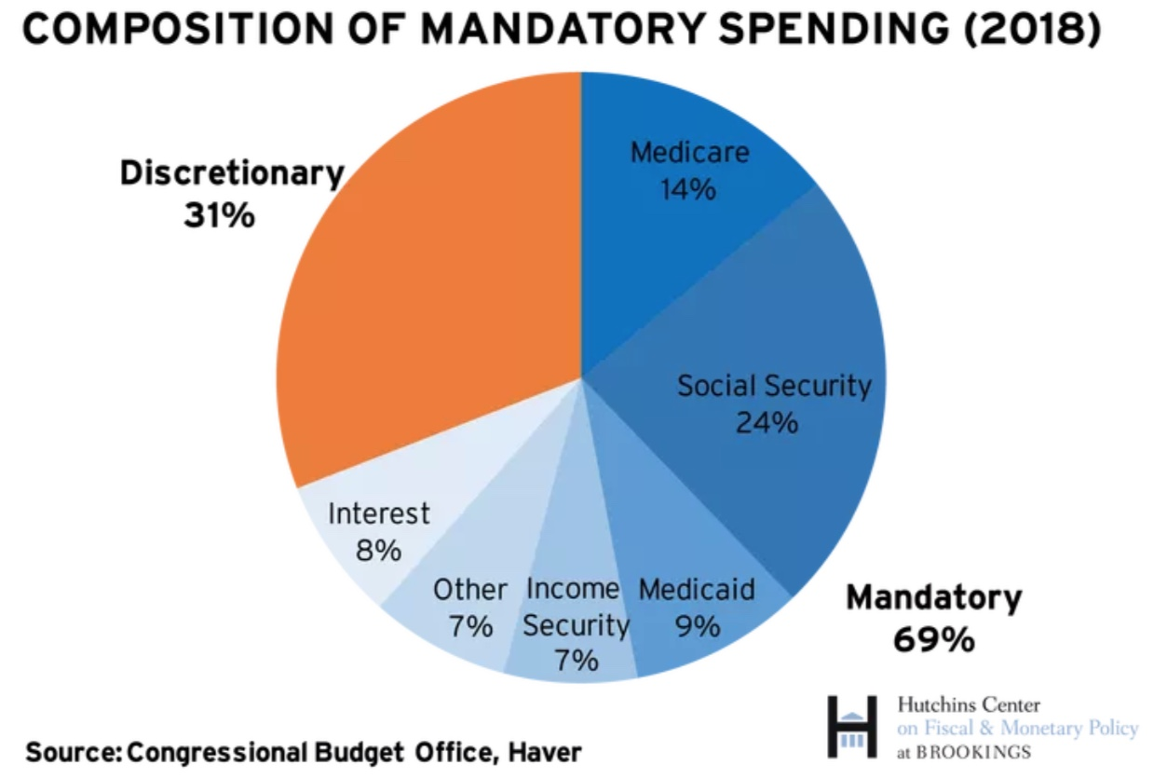
What is Mandatory Spending?
More on this later

Slide 24
What the US Govt. Budget Looked Like 2022
2022 Budget Summary (in billions)
1.4T vs. 2019
Revenue |  |  | Outlays
Income Taxes | $2,632 |  | Mandatory | $4,134
Payroll Taxes | $1,484 |  | Discretionary | $1,661
Corporate Taxes | $425 |  | Interest | $475
Other | $356
Total | $4,897 |  | Total | $6,270
1.4T vs. 2019
Budget Deficit: $1,373 Billion
https://www.cbo.gov/publication/58888
Notes:
https://www.cbo.gov/publication/53627
https://www.cbo.gov/publication/53624

Slide 25
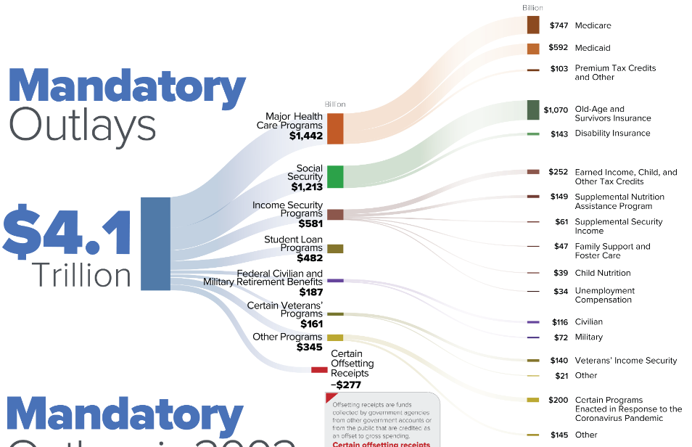
Mandatory Spending (2022)
2022 Budget
https://www.cbo.gov/publication/58889

Slide 26
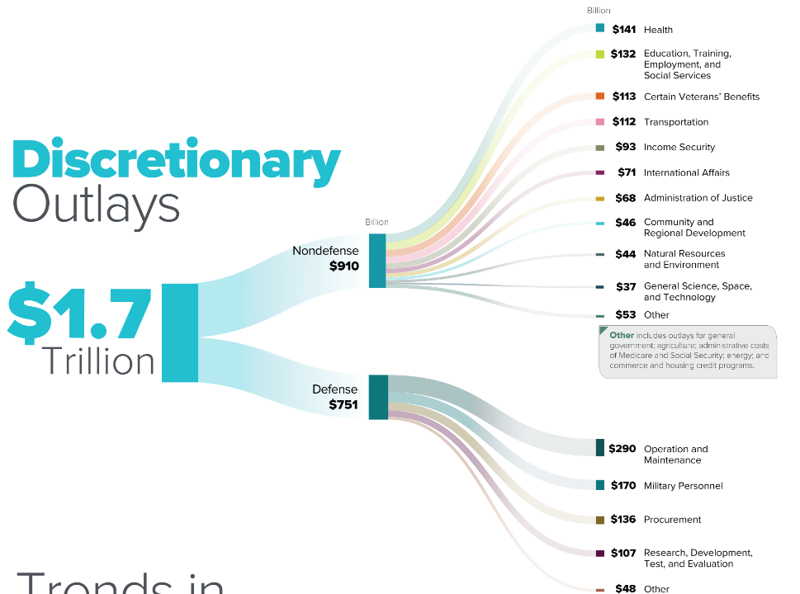
2022 Budget
https://www.cbo.gov/publication/58890

Slide 27
Mandatory Spending: Total Mandatory
Source: Congressional Budget Office (2017)

Slide 28
Mandatory Spending: Social Security Spending
6% annual growth rate
Source: Congressional Budget Office (2017)

Slide 29
Mandatory Spending: Medicare Spending
Avg. Growth 6.8% / yr.
66% b/c rising health care costs
33% from increased enrollment
Source: Congressional Budget Office (2017)

Slide 30
Mandatory Spending: Medicaid Spending
Source: Congressional Budget Office (2017)

Slide 31
Debt: What do we use it for ? (3)
Unexpected emergencies – we need $ now!
Use it for investment (not speculating, economic investment which creates value greater than the cost of capital – ROI>WACC)
  Education
  Think: businesses – using it to grow!
Don’t make enough to cover expenses
Buy things you want now, don’t have the money → implies you will have it later
Big purchases
  Individuals: house, car, education, other
  Gov’t: National Defense, Transportation, Education, other (Discretionary)

Slide 32
2022 Budget
https://www.cbo.gov/publication/58890

Slide 33
Discretionary Spending: Total
Source: Congressional Budget Office (2017)

Slide 34
Discretionary Spending: Defense Spending
Source: Congressional Budget Office (2017)

Slide 35
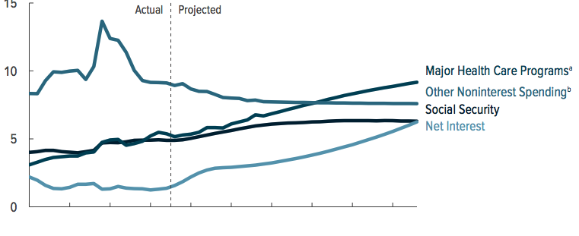
What Are the Primary Drivers Going Forward?

Slide 36
Two Measures of the Deficit
Primary deficit = current programmatic outlays – revenues
Total deficit = primary deficit + interest
Interest on debt:
  Amount owed due to past deficits.
Distinction becomes important for understanding:
  Future course of relative debt
  Costs borne by future generations because of debt

Slide 37
Past and Future of Deficits
=Primary Deficit + Net Interest
Source: CBO, “The Budget and Economic Outlook,” 2/2023
Notes:
Christina Romer: 3 packages war production of 1943.

Slide 38
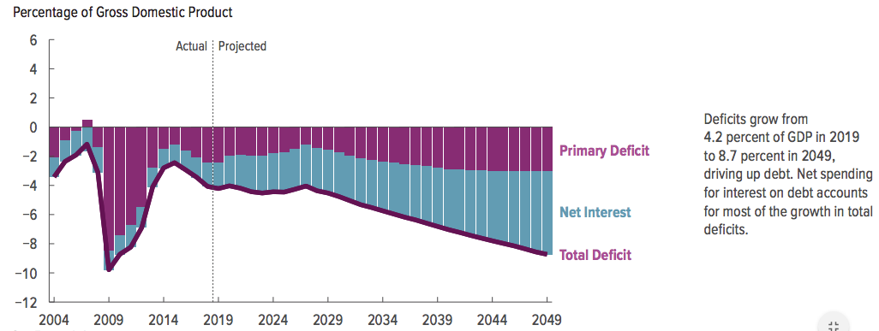
Interest projected to Grow (as share of Deficit)

Slide 39
Spending to Grow Much Faster Than Revenue
Interest, too!

Slide 40
Issue: deficit spending….
Continued deficit spending increases debt. Is this a problem?
  If don’t want deficit spending, then must
    Increase revenue (TAXES)
    Decrease spending (on What?)
    Keep interest on debt from growing….(can we?)
Continued deficit spending increases debt. Is this a problem?

Slide 41
Options considered

Slide 42
Issue: deficit spending grows Debt. Problem?
With personal debt – answer depends on various moving parts, including
  How much you make.
  KEY: “relative” debt is Debt/GDP ratio → rate of GDP growth is key component
  Where do you get debt from?
  How much does it cost you?
  Can you pay it back?

Slide 43
How Does the US Government Borrow?
It issues debt.
  Treasury marketable securities:
    Treasury bills, notes, and bonds
    TIPS: Treasury inflation-protected securities
    Savings bonds
Who buys the debt?
  Other federal agencies
  Individuals and businesses
  State and local governments
  Foreign government and individuals
  Federal Reserve

Slide 44
Traditional View
Repayment a non-issue: unlike private sector debt
  Government doesn’t “pay back” debt.
  Maturing government bonds paid by issuing new bonds (“rolling over” the debt)
  Interest on the debt is essentially paid by the young to previous generation of lenders (who will then get paid off by next generation…and so forth)

Slide 45
A Breakdown of the Total Federal Debt
Sources: US Treasury, Federal Reserve Board
Notes:
China holding od US Treasuries peaked aat 1.3tr in 2013. and more recently has been falling. Japan not so much. 10/6 31.1and 24.3

Slide 46
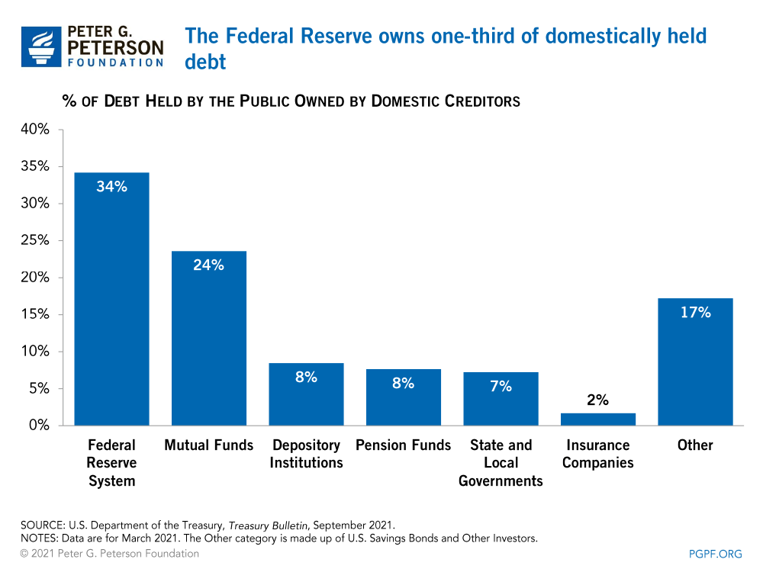
Notes:
Domestic debt held by the Fed is now 37%

Slide 47
Debt from domestic markets
Might reduce availability of funds to other borrowers.
  Often referred to as “crowding out” private investment
Intra-government debt
  DOES NOT crowd out private investment.
  DOES NOT require funding on credit markets
Debt held by the public
  MIGHT ‘crowd out’ private investment: less Private sector investment →smaller capital stock → reduced future output.
  B/C debt funded by borrowing on credit markets and competes with private funding
  → Think like this: savers have choices – bonds, bank, stocks – if give to Govt (bonds), then not there for others to borrow
Little evidence of ‘crowding out’ (worth asking why? Implies funds available from elsewhere)

Slide 48
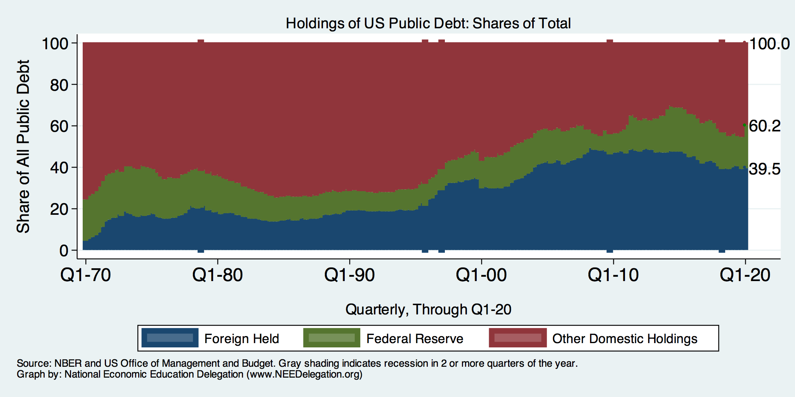
Trends in US Debt Over Time
2020, Q1: Other Domestic: 39.8%
Federal Reserve: 20.7%
Foreign: 39.5%

Slide 49
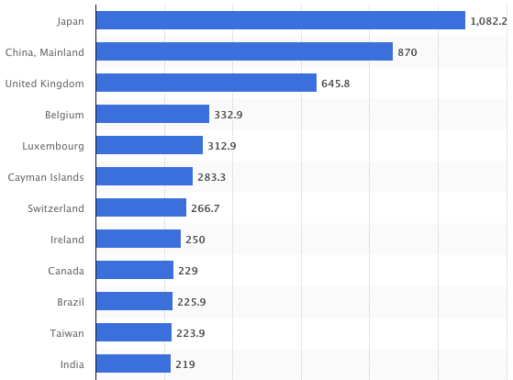
Who Holds Debt: Foreigners, 11/22
Foreign ownership is relatively recent – in 1990 foreign ownership was less than 20%
Billions of U.S. Dollars
Source: https://www.statista.com/statistics/246420/major-foreign-holders-of-us-treasury-debt/

Slide 50
Why do Foreigners Buy US Treasuries
“SAFE HARBOR” (for your savings)
Market for Treasuries is the deepest, most liquid and safest capital market in the world.
US economy has a history of political and economic stability.
We enjoy “An exorbitant privilege” (Valery Giscard d’Estaing): The dollar is the largest international reserve currency.
  Most trade transactions are quoted in dollars, e.g., oil.
  With some exceptions, foreigners borrow in dollars. E.g., Yankee bonds

Slide 51
Trade and Investment Flows Balance Out
Why do Foreigners Buy US Treasuries (2)
This is the “Best Buy” effect

Slide 52
Should Foreigner ownership be concerning?
Why not?
  Currency used for international trade
  Investors that are looking for stable ROI
  Imports & foreign borrowing go hand in hand (The “Best buy” effect)
  Fed holds foreign debt (the “poker game” idea)
Why?
  Interest payments go to foreigners
  Possibility of a “fiscal crisis” (later)

Slide 53
Debt: When does DEBT become a problem?
Can’t pay it back
Creditors demand repayment
Interest rates too high
  Requires higher ROI
  Interest payments eat up too much of income
Gets too big (relative to what?)
Damages credit rating severely
  Hurts ability to borrow again
  Increases cost of borrowing
Things don’t go as planned….
Others?

Slide 54
Debt: When does it become problem?
Can’t pay it back
  Let’s consider this…when won’t US be able to pay it back?

Slide 55
Gets too big (relative to what?)
1946-1974
What can we learn from the 46-74 period, where the relative debt fell continuously?
Relative debt fell in spite of deficits in 21 of the 29 years, while debt increased by 42%.
1946-1974, grew debt, but not as fast as the economy was growing.
While the debt grew by 42%, GDP grew by 550%
Proof that: You don’t need a surplus to reduce the relative debt:
You just need GDP to grow faster than the debt

Slide 56
What about default?
Private sector can default / declare bankruptcy
Stephanie Kelton (Modern Monetary Theorist)
6-6-2020, NYTimes op-ed, “Learn to Love Trillion-Dollar Deficits.”
  US Treasury borrows in dollars and therefore cannot default (as opposed to Greece).

Slide 57
Debt: When does DEBT become problem?
Creditors demand repayment. Consider the following points
  How government borrows (issues bonds & rolls over)
    Mechanics of “repayment”
  Why lenders buy US debt
    ‘Safe Harbor’
    ‘Best Buy’ effect
    Investment in US Economy – what do you want from investment? Failure?
  BUT…fiscal crisis could materialize…

Slide 58
What would a Fiscal Crisis Look Like?
Foreigners lose confidence in the dollar and sell Treasuries in exchange for assets denominated in their own currency,
  Sale of Treasuries raises interest rates, worsening our fiscal outlook.
  Trading of Foreign for US assets lowers US exchange rate.
    Raising the price of imports thereby increasing inflation.
    Lowering the foreign currency returns on all US assets, exacerbating 1.
Could the Fed Bail us Out? – the “poker game”
  Yes - It could buy Treasuries and prevent the rise in interest rates.
  But - Insufficient foreign assets to prevent the fall in the exchange rate,

Slide 59
Debt: When does it become problem?
Interest rates too high
  Requires higher ROI
  Interest payments eat up too much of income

Slide 60
Issue: rising interest payments
More debt means more interest to pay as debt matures
Rising interest rates → cost more to “roll over” debt
Are days of very low interest rates gone?
IF Government spending ‘Crowds Out’ → higher interest rates & fewer loanable funds:
  Increases Foreign Borrowing & FDI:
  Higher interest rates lead to foreign capital inflows or foreign borrowing.
When the Fed raises interest rates, the exchange rate of the dollar rises, causing:
  Increases in the trade deficit
  Foreign borrowing.
IF foreign owners panic, rates up!

Slide 61
What Traditional Economic Theory Got Wrong
Assumed that the interest rate was greater than the growth in GDP
  In order to stabilize the debt, government must run a primary surplus.
  The bigger the debt, the larger the required primary surplus.
More debt today means a higher primary surplus is needed in the future, i.e., higher taxes and/or less programmatic outlays.
BUT….interest rates didn’t behave that way
Notes:
Numerical example: interest rate a 4%; GDP growth at 3%. there must be a primary surplus to offset the interest rate

Slide 62
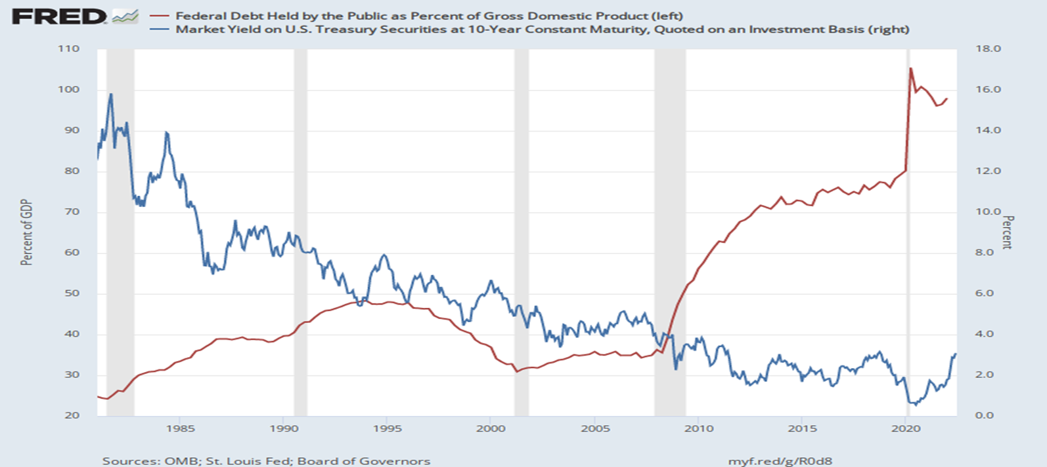
The Dog that Didn’t Bark; Rising Interest Rates?
Blue Line Rate on 10-Yr Treasury Bonds; Red Line Relative Debt

Slide 63
Previously: Past & Future of Deficits
=Primary Deficit + Net Interest
Source: CBO, “The Budget and Economic Outlook,” 2/2023
Notes:
Christina Romer: 3 packages war production of 1943.

Slide 64
Debt: When does DEBT become a problem?
Can’t pay it back
Creditors demand repayment
Interest rates too high
Gets too big (relative to what?)
Damages credit rating severely
  Hurts ability to borrow again
  Increases cost of borrowing
Things don’t go as planned….
Others?

Slide 65
Issue: how big is too big?
Debt is growing b/c
  Primary deficits continue to grow
  Interest payments continue to grow
When should we start to worry that it’s getting too big?
Economists: if traditional view, wrong, then what to think?
  MMT (Kelton)
  Blanchard

Slide 66
New(er) View: MMT’s ‘Free Lunch’
Only limit on deficit spending is if it leads to too much spending thereby increasing current inflation.
Recognizing this fact, “…could free policymakers not only to act boldly amid crises but also to invest boldly in times of more stability.”
Dr. Kelton again
  Example: How did we “find the money” in FY 2020 to increase in the deficit by about $1.9 trillion?
  Answer: Fed open market purchases of $1.7 trillion provided 89% of the financing.
  More generally, she argues that we can always find the money to increase federal spending

Slide 67
MMT’s Free Lunch – maybe not so free…
Recent rise in inflation suggests free and easy application of MMT theories – acting boldly in times of emergency, finding money via Fed, etc – might lead to problems.
Deficit spending needs to be reigned in….?

Slide 68
New View: Almost a Free Lunch
If the interest rate is less than the growth rate of GDP, then Debt to GDP can be stabilized with a (small) primary deficit
Olivier Blanchard (economist @ MIT, Head of IMF..):
Blanchard does believe that the relative debt must be stabilized
  At some point current deficits should be reduced.
  But it may not be crucial at what level of debt we stabilize.
“If the future is like the past [with low interest rates],…the issuance of debt without a later increase in taxes may well be feasible. Put bluntly, public debt may have no fiscal cost.”
But,
“My purpose…is not to argue for more public debt, especially in the current political environment. It is to have a richer discussion of the costs of debt…than is currently the case.”
Notes:
Olivier Blanchard

Slide 69
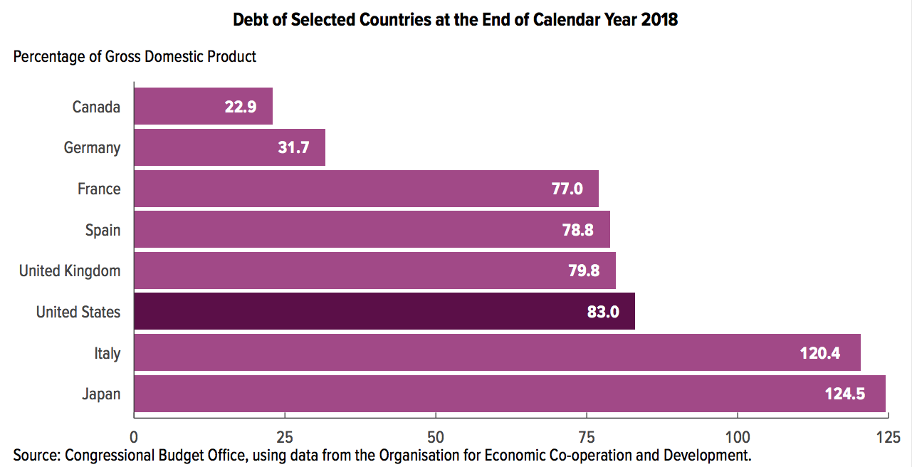
Other Countries Have Higher Debt Levels

Slide 70
Relative Debt Cannot Grow Forever, But
IF Relative does grow, then we encounter issues with lenders
  Interest payments will grow with it.
  Investors might start questioning the creditworthiness of the US government
  Interest rates might increase
  It becomes more difficult to borrow in times of crisis.
  Could start to crowd out investment by consumers and businesses.
  Could be inflationary.
May not present a problem if GDP > Interest rates (Blanchard)

Slide 71
Takeaways / talking points
Can’t technically default, nor technically have to “repay”
  “Rolling over” debt may cost more in future
The current trajectory for the federal debt seems unsustainable
Persistence of deficit spending will increase need to borrow
  What should we cut?
Debt service will increase due to
  Deficit spending, thus more borrowing
  Possible increased interest rates
Good borrowing may become more difficult if relative debt grows
  Economic investment may lack
  Emergency borrowing ability may be constrained
Increased debt service may “crowd out” private investment
Debt held by foreigners increases – may lead to ‘fiscal crisis’
Relative debt stabilization may be handled by combination of GDP growth and low interest rates

Slide 72
Thank you!
Any Questions?
www.NEEDEcon.org
Joseph Carolan, Ph.D.
carolan@oakland.edu
Contact NEED: info@NEEDEcon.org
Submit a testimonial: www.NEEDEcon.org/testimonials.php
Become a Friend of NEED: www.NEEDEcon.org/friend.php

Slide 73
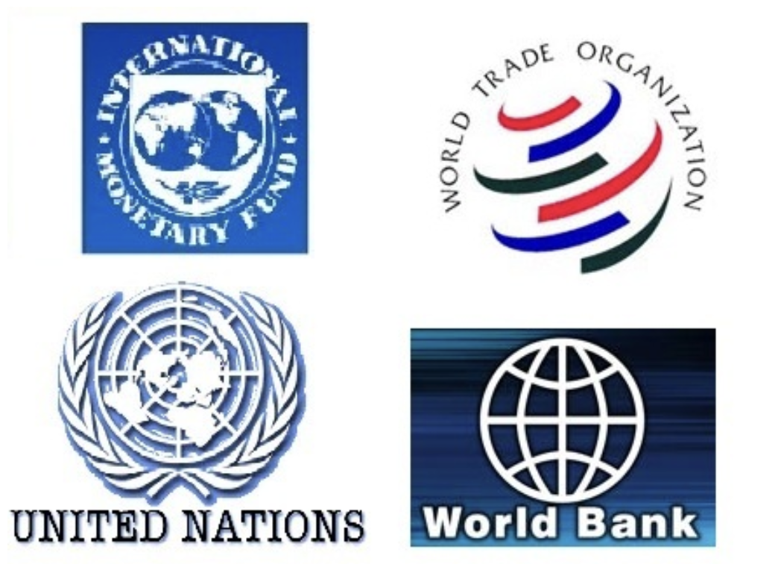
Main Economic Institutions
Notes:
https://sbhshgovapmacro.wordpress.com/2011/06/02/international-institutions/

Slide 74
Federal Debt Glossary
Total Federal Debt is the value of all outstanding government bonds (or “Treasuries”) that have been issued to finance past federal government deficits.
Deficit is the difference between total federal spending and revenues.
Federal Debt in the Held by the Public is the debt held by the private domestic investors, foreign investors and the Federal Reserve. The concept of the debt excludes intragovernmental debt, such as the debt held by the Social Security and Medicare Trust Funds.
The Relative Debt is the Federal Debt Held by the Public as a fraction of the size of the economy, or GDP.
Congressional Budget Office (CBO) is a congressional think tank that analyzes the effect of legislation on the budget (“scoring”) and issues periodic projections on the future of debt and deficits
Primary Deficit is the difference between federal spending on programs and total revenues. The primary deficit excludes interest on the debt.
Rolling Over the Debt the process of paying off maturing government bonds with newly issued bonds

Slide 75
Federal Debt Glossary (Cont.)
Crowding Out is the phenomena where government financing of deficits raises interest rates and lowers firms’ investment.
International Reserve Currency is foreign holdings of US debt (and other countries debt) to facilitate international trade; e.g., oil is traded in dollars.
Default is when an entity that issues a bond fails to make an interest payment or the repayment of the face amount on time.
Foreign Exchange Value of the Dollar is the purchasing power of the dollar in terms of a foreign currency. When the US exchange rate falls, the dollar has les purchasing power over foreign goods.
Budget Reconciliation is a Senate process for by-passing the filibuster, so that legislation can be enacted with a 51-vote majority. The process can only be used for changing spending or taxes and the legislation cannot increase the deficit after 10 years.

